Slide 1
PPG Open Meeting
4th June 2018

Slide 2
Patient Survey 2018
The patient survey ran from 23rd April to 11th May
A total of 527 questionnaires were received, whilst slightly down on the previous two years (687 responses in 2017 and 555 in 2016)
Overall 1,005 comments were received, (784 in 2017)
Quantitative responses to the questions have been analysed – thank you to Diana!
Qualitative comments are being analysed for trends and will inform the action
planning for the year ahead
Thank you to all of those who participated

Slide 3
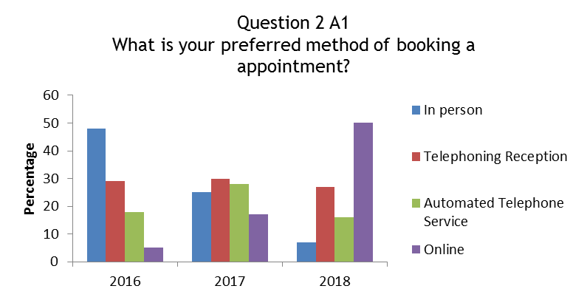
Patient Survey Headline Findings
Significant change in the way patients prefer to book an appointment.
2016 - the most common way was to visit SHC in person and few patients made use of the online service.
2018 this has been reversed - half of the patients choosing to use on the online service and very few now visiting SHC in person.
The telephone service is still well used by patients.

Slide 4
Patient Survey Headline Findings – Appointments
The respondents were very positive about their experience of speaking to a Receptionist to make an appointment; 76% rated it to be at least good
74% of patients were able to make a satisfactory appointment – an encouraging 19% improvement when compared to 2017.
The percentage of patients who have registered to use the on-line appointment system is 70% - a very encouraging rise of 20% since 2017.
Of those who have used the on-line system to book an appointment 83% rated the experience as at least good
The respondents who had ever visited the Practice to make an appointment were also very positive, 72% judged the experience to be at least good

Slide 5
Patient Survey Headline Findings
Performance on the time patients have to wait for their telephone call to be answered has not improved since 2016; unfortunately it has got slightly worse.
When asked to rate the manner in which patients were spoken to when they were able to contact the Practice the responses also show a very slight dip in performance; it was judged to be good or better by 83% of patients (86% in 2017, 84% in 2016).
The most frequently used method to cancel an appointment was by Patient Access (internet) 38% followed very closely by telephoning Reception 36%.
Only a very small percentage of patients, 4.5%, either use text message or visit SHC in person.
Two thirds of the respondents stated that they had never cancelled appointment.

Slide 6
Patient Survey Headline Findings
There are improvements to the length of time that patients had waiting for their consultation when compared to 2017.
When compared to 2017 the percentage of patients who rated their waiting time as reasonable or better, remains the same at 81%.
Prescriptions -when compared to 2017 there has been a 10% increase the percentage of patients who request a repeat prescription on line
30% of respondents now use the SHC website or Patient Access to request a repeat prescription.
There has been an 8% decrease in the percentage of patients who use the pharmacy (38%) and a similar reduction in the percentage of patients who continue to drop off a paper request at the Practice (27%).
As in 2017 88% of respondents found their preferred system easy or very easy to use.

Slide 7
Patient Survey Headline Findings
92% of respondents felt that after a visit to the doctor that their problem or illness was dealt with to their satisfaction.
The time a Doctor spends with patients was rated good to excellent by 68% of patients, which is a 1% increase when compared to 2017.
When asked how patients rated the Doctor’s patience with them and their questions/worries 96% rated reasonable to excellent a slight decrease on 2017 (98%).
The caring and concern by Doctors was again rated highly, as at least good by 85% of patients and reasonable to excellent by 95% of patients (2017 - 97%).
As in 2017 78% of patients would definitely or probably recommend their Doctor to family and friends.

Slide 8
Patient Survey Headline Findings
95%, were satisfied with their visit to the Nurse Practitioner & 89% would definitely or probably recommend the Nurse Practitioner to their family and friends
93% rated the quality of care provided by the Nurse or HCA to be at least good to excellent (an increase of 2% when compared to 2017)
88% would definitely or probably recommend the Practice Nurses or HCAs to family and friends
The percentage of patients who were completely satisfied with the Practice has continued to rise from 12% in 2016 to 24% in 2018
This has doubled in two years and reflects the focus on continual improvement at the Practice. The percentage of patients not satisfied was 14% as in 2015 and 2016 (13% in 2017)
The percentage of respondents who would definitely or probably recommend the Practice to family and friends was 74%, which is a slight decrease when compared to 2017 (77%)

Slide 9
Background
General Practice becoming busier every year
Increasingly - care is moving from Secondary to Primary Care
Complexity of what the practice team is seeing is increasing
Pressure to deal with complex medical problems in 10 minute appointments
Home visits a major impact on GP’s time
Recruitment is challenging – GP’s in demand with plenty of opportunity for portfolio careers and locum sessions rather than traditional General Practice
Social & community care under pressure with budget cuts resulting in patients coming to their GP Practice and not other providers
Property issues – meeting the space requirements of the practice is a continuing challenge

Slide 10
Developments to meet the challenges
Development of a Multi-disciplinary team:-
Training Practice – for GP’s & Nurses
2 Nurse Practitioners
Clinical Pharmacist started last month – Bhavini Velji
Increased nursing team – 4 nurses & 2 HCA’s
2 Phlebotomists - 5 days a week service
Increased reception team – it is taking time to train new team members
We now have 50 staff in our team
Considering a Paramedic as our next development
Premises - the current practice size requires 14 clinical rooms for our 18,700 patient population
We have increased the practice space allocation by 4 rooms to provide 14 clinical rooms – however 3 are temporarily allocated while leases and service charges are negotiated

Slide 11
Developments to meet the challenges
Working effectively with the Patient Participation Group
Updated the waiting room - Art work project
Cut out the morning queue
Better communication/ newsletter / Sunbury Matters
Working group meeting in June to review capacity planning and appointment bookings & prescription processes
Action planning in response to results of the patient survey

Slide 12
Developing additional services
Hub for the extended access clinics over the winter months
Have put ourselves forward to continue this – potential to become a hub at evenings and weekends
Hearing clinic – ear microsuction - due to develop this further and will become free from June
Smoking Clinic – Quit 51 – positive take up of this service
Ultrasound clinic
Developing Wellbeing Prescribing – signposting to local services
Clinical pharmacist spearheading a drive to improve prescription processing
Greater use of online services – most effective way to book appointments and manage prescriptions

